Slide 1
Automatic Medical Image Segmentation
Tyler Ruch

Slide 2
Topic
Medical Imaging technology is improving very quickly
Large amounts of medical images go unlabeled, because labelling must be done by experts
Identifying features within medical images is useful for a large number of tasks, including:
Pathology
Research experiments
Disease diagnosis

Slide 3
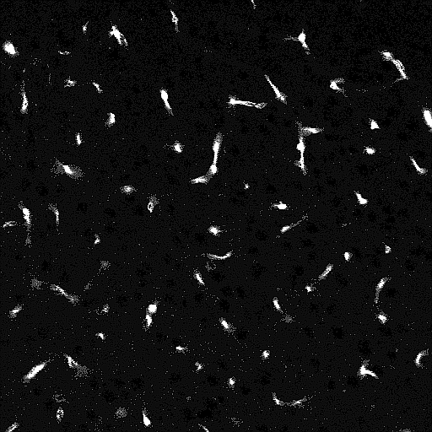
Task
Identification of pericyte and differentiation between pericyte and smooth muscle cells in high resolution electron microscopy images of mouse brains
Massive amount of unlabeled data, hundreds of terrabytes of datasets
Scans have a 5 micron voxel size; very small
Scans are greyscale; output will be black+white masks
Cells have a distinct shape within the scans

Slide 4
Approach
Use a 2 dimensional approach at first
Start by using histogram thresholding, perhaps use pyramid mean-shift or gaussian blur first
Analyze connected components of thresholded image for:
Size; only take the components < n pixels in size
Shape; only take components shaped like an oval\
Afterwards, move into the z plane. Use 3D connected components and 3D region growing based on previous frame

Slide 5
Benchmarking
Benchmarking and testing will be performed against small ground-truth dataset produced by neuroscientist experts
Benchmarking will be performed by:
Directly comparing the produced masks with the ground truth data
Training a 2D or 3D CNN using the masks as training sets and the ground truth data as the test set
The degree of CNN usage will depend on time

Slide 6
hypothesis
Using 2D or 3D automatic methods will yield a dataset that is ~80-90% as accurate as human ground truth, because human ground truth has variance based on expert opinion
This can create a massive dataset that can train a CNN to produce masks that are nearly identical to expert ground truth masks

Slide 7
uses
This dataset and the segmentation on it will be used in future neuroscience experiments.
Ultimately, the masks could be used to automatically count the cells in the 3D space, which could provide data for experiments such as:
Causes for Alzheimer’s disease
Effects of aging on the brain on a super-micro level
Effects of strokes on the brain on a super-micro level

